Slide 1
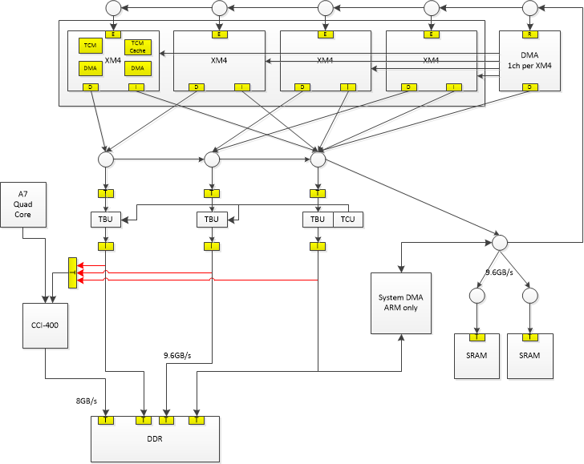
CEVA-ARM Test Plan
Simplified System View

Slide 2
Test Plan – Simple
Boot up
ARM power up/down CEVA
ARM enable CEVA run: bare metal
CEVA self boot
Connection Check
CPU R/W 4 DSP CPM registers and TCM
CPU R/W DMA registers
DSP R/W self and other DSP CPM registers and TCM
DSP program DMA registers
Communication
Interrupt
MCCI
DMA Queue and SEM

Slide 3
MMU and Coherency
 | MMU bypass (PA) |  | MMU enable(VA)
 | Coherent | None-coherent | Coherent | None-coherent
DSP LD/ST DDR memory
DSP internal DMA(P/D) between DDR memory and TCM
DSP external DMA between DDR memory and L2-SRAM
DSP external DMA DDR to DDR
DSP program cache enable

Slide 4
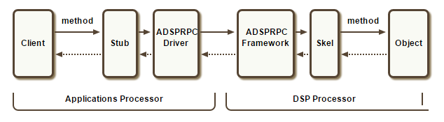
Test Plan – Programming model
Scene on bare metal
ARM RPC framework
RTOS on CEVA
SMP + AMP
Problems:
Multi-thread
Context switch is hard: TCM,
DLL compile, load
Queue Based or MCCI based communication
Memory Allocation and protection
Task Scheduling
Synchronization Primitives: mutex/semaphore
Exclusive Access and atomic operation

Slide 5
Test Plan – Application Level
See Use Case
Elaborate
w. ISP
Audio wakeup – ceva + i2s -> wake up a7

